Slide 1
Discrete Mathematics and Logic (UE17CS205)
Unit 3 - Counting
Mr. Channa Bankapur (channabankapur@pes.edu)
Department of CS&E, PES University

Slide 2
Counting is a basic human trait. There is archeological evidence suggesting that humans have been counting for at least 50,000 years.
Combinatorics is the study of arrangement of objects.
Counting is the significant part of Combinatorics. It is the action of finding the number of elements of a finite set of objects.
In mathematics, the essence of counting a set (cardinality of) and finding a result n, is that it establishes a one-to-one correspondence of the set with the set of natural numbers {0, 1, 2, ..., n}.

Slide 3
Applications of Counting:
There are uncountable (sorry, countable, but large) number of applications of counting. Here are the ones you need in the near future.
Probability
Graph Theory
Analysis of algorithms.
Design of Algorithms
Algorithms which inherently need counting methods like in Analytics.
…

Slide 4
The kind of problems dealt in this Unit:
Suppose that a password for an encrypted network packet is 8 to 15 characters long. The password is alphanumeric and case-sensitive. The password has at least one digit and at least one alphabet.
How many passwords a hacker needs to loop through to decode a network packet in the worst-case?
<You don’t have to try to solve this for now!>

Slide 5
Topics to be covered in Counting:
The Product Rule and the Sum Rule
The Pigeonhole Principle
Permutation and Combination
Binomial Theorem and Coefficients
Permutations and Combinations with Repetition
Arrangement of (un)labelled objects in (un)labelled boxes

Slide 6
Suppose, you are asked to choose a course from Elective-1 pool and one from Elective-2 pool. There are 5 courses offered in Elective-1 pool and 4 courses in Elective-2 pool. How many different ways are there for you to choose a pair of Elective-1 and Elective-2 ?
Suppose, department of CSE is offering 5 courses in Elective-1 pool and department of ECE is offering 4 courses in Elective-1 pool. A student is asked to choose one course from Elective-1 pool irrespective of the department. How many different ways are there for you to choose a course in Elective-1 ?
CSE offers 5 and 4 courses, ECE offers 4 and 3 courses for E-1 and E-2 pools, respectively. How many different ways are there for you to choose a pair of Elective-1 and Elective-2 ?

Slide 7
The Product Rule
Suppose that a procedure can be broken down into a sequence of two tasks. If there are n₁ ways to do the first task and for each of these ways of the first task, there are n₂ ways to do the second task, then there are n₁*n₂ ways to do the procedure.
Eg: To order a pizza, you first choose the type of crust: thin or deep dish (2 choices). Next, you choose the topping: cheese, pepperoni, or sausage (3 choices). Therefore, there are
2 × 3 = 6 possible ways of ordering a pizza.

Slide 8
Eg: Suppose, there are 7 trains from Bangalore to Mumbai and 3 trains from Mumbai to Ahmedabad. In how many ways our Pappu can reach Ahmedabad from Bangalore?
Soln: From Bangalore to Mumbai, Pappu has 7 choices (because there are 7 trains, he can pick anyone). For each of the choice of the first stage, he has 3 choices from Mumbai to Ahmedabad.
Total # of ways = 7 ways x 3 ways = 21 ways.
Pappu can reach Ahmedabad in 21 different ways.

Slide 9
What does it return?
foo(n)
ctr ← 0
for i ← 1 to 20
for j ← 1 to 30
ctr ← ctr + 1
return ctr
Return value: …

Slide 10
What does it return?
foo(n)
ctr ← 0
for i ← 1 to 20
for j ← 1 to 30
ctr ← ctr + 1
return ctr
Return value: Return value: 20*30 = 600
(the product rule)

Slide 11
Eg: Suppose there are 10 contestants for a race. There will be a 1st and a 2nd prize winners. In how many ways the prizes can be awarded?
Soln: …

Slide 12
Eg: Suppose there are 10 contestants for a race. There will be a 1st and a 2nd prize winners. In how many ways the prizes can be awarded?
Soln: There are 10 ways to choose the 1st prize winner. For each of the 10 ways, there are 9 ways to choose the 2nd prize winner.
Therefore, 10 * 9 = 90 ways.

Slide 13
Eg: Suppose there are five empty chairs in a row. A couple (two people) is allowed to occupy any of the seats. How many unique ways are there for them to sit?
OR
How many ways are there to arrange two people in five chairs?
Soln: …

Slide 14
Eg: Suppose there are five empty chairs in a row. A couple (two people) is allowed to occupy any of the seats. How many unique ways are there for them to sit?
OR
How many ways are there to arrange two people in five chairs?
Soln: 5 * 4 = 20 ways
Orders matters here. It’s not just about which two chairs are occupied. It’s also about who among the two sits on it.
That is, chairs are labeled and so are the people.

Slide 15
Eg: Suppose there are five empty chairs in a row. Three people are allowed to occupy any of the seats. How many unique ways are there for the them to sit?
Soln: …

Slide 16
Eg: Suppose there are five empty chairs in a row. Three people are allowed to occupy any of the seats. How many unique ways are there for the them to sit?
Soln: 5 * 4 * 3 = 60 ways
Eg: Suppose there is a pool of five elective courses to choose one from. Three friends choose one each. In how many ways they can choose the electives?
Soln: …

Slide 17
Eg: Suppose there are five empty chairs. Three people are allowed to occupy any of the seats. How many unique ways are there for the them to sit?
Soln: 5 * 4 * 3 = 60 ways
Eg: Suppose there is a pool of five elective courses to choose one from. Three friends choose one each. In how many ways they can choose the electives?
Soln: 5 * 5 * 5 = 125 ways
Choices are allowed with replacement.
In the previous example of “seats”, it’s without replacement.

Slide 18
Generalization of the Product Rule
Suppose that a procedure is carried out by performing the tasks T₁, T₂, …, T_{m} in sequence. If each task T_{i} can be done in n_{i} ways, regardless of how the previous tasks were done, then there are n₁ * n₂ * … * n_{m} ways to do the procedure.
Eg: When assembling a certain type of computer, there are 3 choices of hard drive, 4 choices for the amount of memory, 2 choices of video card, and 3 choices of monitor. The number of ways a computer can be assembled is 3*4*2*3 = 72 ways.

Slide 19
Eg: Suppose there are 10 contestants for a race. There will be a 1st, a 2nd and a 3rd prize winners. How many ways the prizes can be awarded?
Soln: There are 10 ways to choose the 1st prize winner. For each of the 10 ways, there are 9 ways for the 2nd prize winner. For each of the 10 * 9 ways, there are 8 ways for the 3rd prize winner.
Therefore, 10 * 9 * 8 = 720 ways.

Slide 20
Eg: Suppose four people sit on four of the available five empty chairs. How many ways are there for them to sit when the order of their seating matters?
Soln: There are 5 ways to choose a chair for the first person. For each of the 5 ways, there are 4 ways for the second person to choose a chair. For each of the 5*4 ways, there are 3 ways for the third person to choose a chair. For each of the 5*4*3 ways, there are 2 ways for the fourth person to choose a chair.
Therefore, 5 * 4 * 3 * 2 = 120 ways.

Slide 21
Eg: Suppose that a password for encrypted network packet is eight characters long, alphanumeric and case-sensitive. How many passwords a hacker needs to loop through to decode the network packet in the worst-case?
Soln: …

Slide 22
Eg: Suppose that a password for encrypted network packet is eight characters long, alphanumeric and case-sensitive. How many passwords a hacker needs to loop through to decode the network packet in the worst-case?
Soln: 62*62*62*62*62*62*62*62 = 62⁸ different possibilities of the password.

Slide 23
What is the value of ctr printed?
ctr = 0
for i = 1 to 100
for j = 1 to 500
for k = 1 to 1000
ctr = ctr + 1
print ctr
Output: …

Slide 24
What is the value of ctr printed?
ctr = 0
for i = 1 to 100
for j = 1 to 500
for k = 1 to 1000
ctr = ctr + 1
print ctr
Output: 50,000,000
(= 100 * 500 * 1000)

Slide 25
What is the value of k printed?
k = 0
for i₁ = 1 to n₁
for i₂ = 1 to n₂
.
.
for i_{m} = 1 to n_{m}
k = k + 1
print k
Output: n₁ * n₂ * ... * n_{m}

Slide 26
Eg: An ATM card takes a 4-digit secret pin code to draw money from the ATM. Suppose a thief steals an ATM card. How many combinations the thief has to try at worst to steal some money?
Soln: …
Eg: What if the thief knows that the pin code has unique digits in it (no digit is repeated) ?
Soln: …
Eg: What if the thief knows that the pin code is a palindrome (it reads the same backwards as forwards) ?
Soln: …

Slide 27
Eg: An ATM card takes a 4-digit secret pin code to draw money from the ATM. Suppose a thief steals an ATM card. How many combinations the thief has to try at worst to steal some money?
Soln: 10 * 10 * 10 * 10 = 10⁴ different possibilities of the pin code.
Eg: What if the thief knows that the pin code has unique digits in it (no digit is repeated) ?
Soln: 10 * 9 * 8 * 7 = 5040
Eg: What if the thief knows that the pin code is a palindrome (it reads the same backwards as forwards) ?
Soln: 10*10*1*1 = 100

Slide 28
The Sum Rule
If a task can be done in one of n₁ ways or in one of n₂ ways, where none of the set of n₁ ways is the same as any of the set of n₂ ways, then there are n₁+ n₂ ways to do the task.
Eg: CSE department offers five elective courses and ECE department offers four electives for an electives pool from which a student has to pick one. How many different ways a student can pick if he/she is allowed to pick only one elective?
Soln: 5 + 4 = 9 choices

Slide 29
Generalization of the Sum Rule
If a task can be done in one of n₁ ways or in one of n₂ ways or … or in one of n_{m} ways, then there are n₁+n₂ +…+n_{m} ways to do the task.
Eg: CSE department offers five elective courses, ECE department offers four and MCA department offers two for an electives pool from which a student has to pick one. How many different ways a student can pick if he/she is allowed to pick only one elective?
Soln: 5 + 4 + 2 = 11 choices

Slide 30
Eg: Suppose that a password for an encrypted network packet is 3 to 5 characters long, alphanumeric and case-sensitive. How many passwords a hacker needs to loop through in the worst case to decode the network packet?
Soln: …

Slide 31
Eg: Suppose that a password for an encrypted network packet is 3 to 5 characters long, alphanumeric and case-sensitive. How many passwords a hacker needs to loop through in the worst case to decode the network packet?
Soln: Number of passwords of length 3:
62*62*62 = 62³ ---using the product rule
Number of passwords of length 3, 4 or 5:
62³ + 62⁴ + 62⁵ ---using the sum rule

Slide 32
What is the value of k printed?
k=0
for i₁=1 to n₁
k = k+1
for i₂=1 to n₂
k = k+1
.
.
for i_{m}=1 to n_{m}
k = k+1
print k
Output: n₁+ n₂+...+ n_{m}

Slide 33
What is the value of ctr printed?
ctr = 0
for i = 1 to 10
for j = 1 to 50
for k = 1 to 10
ctr = ctr + 1
for i = 1 to 20
for j = 1 to 60
for k = 1 to 10
ctr = ctr + 1
print ctr
Output: …

Slide 34
What is the value of ctr printed?
ctr = 0
for i = 1 to 10
for j = 1 to 50
for k = 1 to 10
ctr = ctr + 1
for i = 1 to 20
for j = 1 to 60
for k = 1 to 10
ctr = ctr + 1
print ctr
Output: 17,000
( = 10 * 50 * 10 + 20 * 60 * 10)

Slide 35
Eg: In an earlier version of the computer programming language BASIC, the name of a variable is a string of one or two alphanumeric case-insensitive characters. Moreover, a variable name must begin with a letter and must be different from the five keywords of two character length. How many different variable names are there in this version of BASIC?
Soln: …

Slide 36
Eg: In an earlier version of the computer programming language BASIC, the name of a variable is a string of one or two alphanumeric case-insensitive characters. Moreover, a variable name must begin with a letter and must be different from the five keywords of two character length. How many different variable names are there in this version of BASIC?
Soln: 26 + (26 * 36 - 5)
= 26 + 931 = 957

Slide 37
Eg: Suppose the password for a system is 6 characters long where each character is a lowercase letter or a digit. Each password must contain at least one digit. How many possible passwords are there?
Soln: …

Slide 38
Eg: Suppose the password for a system is 6 characters long where each character is a lowercase letter or a digit. Each password must contain at least one digit. How many possible passwords are there?
Soln: (36⁶ - 26⁶) = 1,867,866,560
Why are the following not correct?
36⁵ * 10 = 604,661,760
36⁵ * 10 * 6 = 3,627,970,560
36⁵ + 10 * 6 = 60,466,236
(26⁵ + 10) * 6 = 71,288,316

Slide 39
Eg: Suppose the password for a system is 6 to 8 characters long where each character is a lowercase letter or a digit. Each password must contain at least one digit. How many possible passwords are there?
Soln: …

Slide 40
Eg: Suppose the password for a system is 6 to 8 characters long where each character is a lowercase letter or a digit. Each password must contain at least one digit. How many possible passwords are there?
Soln: (36⁶ - 26⁶) + (36⁷ - 26⁷) + (36⁸ - 26⁸)

Slide 41
Eg: An RTO in India has an unique code. For example, the code for Jayanagar-Bangalore is KA05. Suppose the licence number plates issued by the Jayanagar RTO are in the format KA05-XX-YYYY, where an ‘X’ represents an uppercase English letter and a ‘Y’ represents a digit. How many unique licence numbers the Jayanagar RTO can issue?
Soln: …
Eg: How many different bit strings of length eight are there?
Soln: …

Slide 42
Eg: An RTO in India has an unique code. For example, the code for Jayanagar-Bangalore is KA05. Suppose the licence number plates issued by the Jayanagar RTO are in the format KA05-XX-YYYY, where an ‘X’ represents an uppercase English letter and a ‘Y’ represents a digit. How many unique licence numbers the Jayanagar RTO can issue?
Soln: 26 * 26 * 10 * 10 * 10 * 10
= 26² * 10⁴
= 6,760,000

Slide 43
Eg: How many different bit strings of length eight are there?
Soln: 2 * 2 * 2 * 2 * 2 * 2 * 2 * 2
= 2⁸
= 256
Eg: How many bit strings of length eight starts with “1” and ends with “00”?
Soln: …

Slide 44
Eg: How many bit strings of length eight start with a ‘1’ and end with ‘00’?
Soln: 1 * 2 * 2 * 2 * 2 * 2 * 1 * 1
= 2⁵
= 32
Eg: How many bit strings of length eight start with a ‘1’ or end with ‘00’?
Soln: …

Slide 45
Eg: How many bit strings of length eight start with a ‘1’ or end with ‘00’?
It is not 2⁷ + 2⁶ because the objects like 1xxxxx00 are counted twice.
Soln: 2⁷ + 2⁶ - 2⁵
= 128 + 64 - 32
= 160
Alternate method:
Soln: 2⁸ - (1 * 2⁵ * 3)
= 256 - 96
= 160

Slide 46
The Inclusion-Exclusion Principle
(aka Subtraction Principle)
It’s essentially subtracting some cases out of the Sum rule.
In the Sum rule, we add the possibilities of two stages of the procedure because there is no overlap among the stages.
In cases where there is a partial overlap between the stages of the procedure, we need to subtract the common cases after applying the Sum rule.
|A₁ U A₂| = |A₁| + |A₂| - |A₁ ∩ A₂|

Slide 47
Eg: How many subsets of a set with 100 elements have more than one element?
Soln: …
Eg: A palindrome is a string that reads same backwards as forwards. How many bit strings of length n are palindromes?
Soln: …

Slide 48
Eg: How many subsets of a set with 100 elements have more than one element?
Soln: 2¹⁰⁰ - (1+100)
Eg: A palindrome is a string that reads same backwards as forwards. How many bit strings of length n are palindromes?
Soln: 2^{ceil(n/2)}

Slide 49
Eg: In how many ways can a photographer at a wedding arrange 6 people in a row from a group of 10 people, where the bride and the groom are among these 10 people, if
the bride must be in the picture?
both bride and groom must be in the picture?
exactly one of the bride and the groom is in the picture?
Soln:
a. …
b. …
c. …

Slide 50
Eg: In how many ways can a photographer at a wedding arrange 6 people in a row from a group of 10 people, where the bride and the groom are among these 10 people, if
the bride must be in the picture?
both bride and groom must be in the picture?
exactly one of the bride and the groom is in the picture?
Soln: 10*9*8*7*6*5 = 151200
a. 151200 - (9*8*7*6*5*4) = 90720 OR
9*8*7*6*5*(6) = 90720
b. 8*7*6*5*(5*6) = 50400
c. 8*7*6*5*4*(6+6) = 80640
151200 - (50400 + 8*7*6*5*4*3)

Slide 51
Eg: In how many ways can a photographer at a wedding arrange 6 people in a row, including the bride and the groom, if
the bride must be next to the groom?
the bride is not next to the groom?
the bride is positioned somewhere to the left of the groom?
Soln:
…
…
…

Slide 52
Eg: In how many ways can a photographer at a wedding arrange 6 people in a row, including the bride and the groom, if
the bride must be next to the groom?
the bride is not next to the groom?
the bride is positioned somewhere to the left of the groom?
Soln: 6*5*4*3*2*1 = 720
5*4*3*2*1*(2) = 240
720 - 240 = 480
720/2 = 360

Slide 53
Eg: How many bit strings of length seven begin with two 0s or end with three 1s?
Soln: …
Eg: How many bit strings of length ten begin with three 0s or end with two 0s?
Soln: …

Slide 54
Eg: How many bit strings of length seven begin with two 0s or end with three 1s?
Soln: 2⁵ + 2⁴ - 2²
Eg: How many bit strings of length ten begin with three 0s or end with two 0s?
Soln: 2⁷ + 2⁸ - 2⁵

Slide 55
Are these statements true?
Suppose 11 pigeons flies into a set of 10 pigeonholes to roost. At least one of the 10 pigeonholes must have at least 2 pigeons in it.
When 11 random single-digit nonnegative integers are generated, at least one of them is generated at least twice.
For a positive integer k, if k + 1 or more objects are placed into k boxes, then there is at least one box containing two or more objects.

Slide 56
Theorem: The Pigeonhole Principle
If k is a positive integer and k + 1 or more objects are placed into k boxes, then there is at least one box containing two or more objects.
Proof: by contraposition.
If none of the k boxes contains more than one object, then total number of objects cannot be more than k.
Corollary: A function f from a set with k+1 or more elements to a set with k elements cannot be one-to-one.

Slide 57
Examples of the pigeonhole principle:
Among a group of 480 students, there must be at least two with the same birthday.
Among a group of 367 people, there must be at least two with the same birthday.
In a random collection of 27 letters, there must be at least two similar letters.
How many students must be there in a classroom to guarantee that at least two students receive the same score in the test, if the test is graded on a scale from 0 to 40 marks (rounded off to whole numbers)?
Soln: 42

Slide 58
Eg: Show that for every positive integer n, there is a multiple of n that has only 0s and 1s in its decimal expansion.
Soln:
Consider n + 1 integers 1, 11, 111, …, 11...1 (the last one has n + 1 digits)
According to the Pigeonhole principle, at least two of them has the same remainder when divided by n.
Difference of the two numbers with the same remainders is a multiple of n and has only 0s and 1s.

Slide 59
Eg: Suppose 21 pigeons flies into a set of 10 pigeonholes to roost. Then at least one of the 10 pigeonholes must have at least 3 pigeons in it.
Eg: I take 16 hours of lectures in a week of 5 days. On at least on one of the days, I have to take at least 4 hours of lectures.

Slide 60
Eg: Suppose 21 pigeons flies into a set of 10 pigeonholes to roost. Then at least one of the 10 pigeonholes must have at least 3 pigeons in it.
The Generalized Pigeonhole Principle:
If N objects are placed into k boxes, then there is at least one box containing at least ⌈N/k⌉ objects.
Eg: Among 60 students in a classroom, there are at least ⌈60/7⌉ = 9 who are born on the same day of the week.

Slide 61


Slide 62
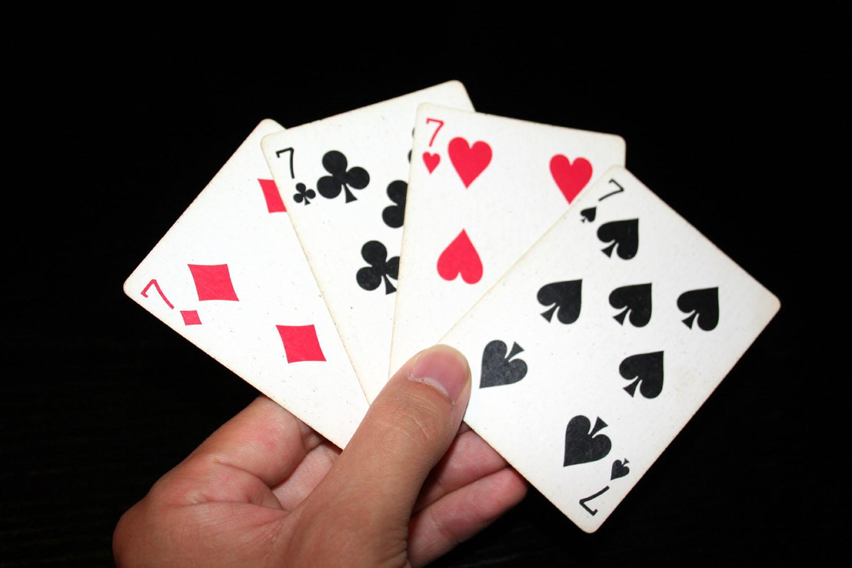
Eg: What is the minimum number of cards that must be drawn from a standard deck of 52 cards to guarantee that at least three cards of the same suit are chosen?
Soln: …
Eg: What is the minimum number of cards that must be selected to guarantee that at least three hearts are selected?
Soln: …

Slide 63
Eg: What is the minimum number of cards that must be drawn from a standard deck of 52 cards to guarantee that at least three cards of the same suit are chosen?
Soln: Lowest nonnegative int x for which ceil(x/4) = 3.
Therefore, x = 9
Eg: What is the minimum number of cards that must be selected to guarantee that at least three hearts are selected?
Soln: 39 + 3

Slide 64
Harder problems (pigeonhole principle):
Eg [OPTIONAL]: During a month with 30 days, a baseball team plays at least one game a day, but no more than 45 games (in the month). Show that there must be a period of some number of consecutive days during which the team must play exactly 14 games.
Eg: 1,1,2,1,3,2,1,1,1,4,5,1,1,1,1,1,2,1,1,1,1,1,2,3,1,1,1,2,1,1

Slide 65
Eg: 1,1,2,1,3,2,1,1,1,4,5,1,1,1,1,1,2,1,1,1,1,1,2,3,1,1,1,2,1,1
a_{j} be the number of games played till j^{th} day.
a₁, a₂, …, a₃₀.
Eg: 1,2,4,5,8,10,11,12,13,17,22,23, …, 41,43,44,45
This is a strictly increasing sequence of distinct integers in the range [1,45].
a₁+14, a₂+14, …, a₃₀+14 is a strictly increasing sequence of distinct integers in the range [15,59]
Eg: 15,16,18,19,22, …, 55,57,58,59

Slide 66
a₁, a₂, …, a₃₀ is a strictly increasing sequence of distinct integers in the range [1,45].
a₁+14, a₂+14, …, a₃₀+14 is a strictly increasing sequence of distinct integers in the range [15,59].
Put together, 60 integers in the range [1,59]
By Pigeonhole principle, at least two of these integers are equal.
∃i ∃j a_{i} = a_{j} + 14 and i > j
1 ,1 ,2 ,1 ,3 ,2 ,1 ,1 ,1 ,4 ,5 ,…
1 ,2 ,4 ,5 ,8 ,10,11,12,13,17,22,… (a₁, a₂, a₃, …)
15,16,18,19,22,… (a₁+14, a₂+14, a₃+14, …)

Slide 67
By Pigeonhole principle, at least two of these integers are equal.
∃i ∃j a_{i} = a_{j} + 14 and i > j
01,01,02,01,03,02,01,01,01,04,05,...
a_{i}: 01,02,04,05,08,10,11,12,13,17,22,...
a_{i}+14: 15,16,18,19,22,...
In the example, a₁₁ = a₅+14 = 22. Until day 5, they’ve played 08 games and until day 11, they’ve played another 14 games (from day 5+1 to day 11).
That is, 14 games were played from day j+1 to day i.

Slide 68
Eg [OPTIONAL]: During a month with 30 days, a baseball team plays at least one game a day, but no more than 45 games (in the month). Show that there must be a period of some number of consecutive days during which the team must play exactly 14 games.
Eg [OPTIONAL]: … exactly 13 games?
Yes, there’ll be such a period for sure.
Eg [OPTIONAL]: … exactly 15 games?
No, we cannot be sure of that, at least by using the above method.

Slide 69
Eg [OPTIONAL]: Show that among any n+1 positive integers not exceeding 2*n, there must be an integer that divides one of the other integers.
Soln: …

Slide 70
Soln: a₁, a₂, …, a_{n+1}
Write these in the form a_{j} = q_{j} * Power(2,k_{j}) where q_{j} is odd.
Eg: n = 4. Therefore, 2n = 8.
Let n+1 numbers in [1,2n]: 2,3,4,5,7
We can write them as: 1*2¹, 3*2⁰, 1*2², 5*2⁰, 7*2⁰
There are n+1 q_{j} odd numbers.
There can be only n unique odd numbers in [1,2n].
∴ By pigeonhole principle, there are at least two q_{j} numbers (say q_{a} and q_{b}) which are equal (q_{a} = q_{b}).
The two numbers of the above n+1 numbers having q_{a} = q_{b} are Power(2,k_{a})* q_{a} and Power(2,k_{b}) * q_{b}
Because q_{a} = q_{b}, Power(2,k_{a})*q_{a} divides Power(2,k_{b})*q_{b} if k_{a} < k_{b}, otherwise Power(2,k_{b})*q_{b} divides Power(2,k_{a})*q_{a}.

Slide 71
[OPTIONAL]
Theorem: Every sequence of n² + 1 distinct real numbers contains a subsequence of length n+1 that is either strictly increasing or strictly decreasing.
Eg: for n=3; 8,11,9,1,4,6,12,10,5,7
There is a subsequence of 4 (=3+1) numbers with strictly increasing or strictly decreasing.
11,9,6,5
Eg: 2,1,5,9,3,10,7,4,8,6
1,3,4,6

Slide 72
[OPTIONAL] Theorem: Every sequence of n² + 1 distinct real numbers contains a subsequence of length n+1 that is either strictly increasing or strictly decreasing.
Proof: a₁, a₂, …, a_{n*n+1}
Ordered pairs
(longest strictly increasing subsequence starting at a_{k},
longest strictly decreasing subsequence starting at a_{k})
(i₁,d₁), (i₂,d₂), …, (i_{k},d_{k}), …, (i_{n*n+1} ,d_{n*n+1} )

Slide 73
(i₁,d₁), (i₂,d₂), …, (i_{k},d_{k}), …, (i_{n*n+1} ,d_{n*n+1} )
Suppose i_{k} and d_{k} are in [1,n] for all k in [1, n²+1]. We’ll prove this is a contradiction and hence there exists a k for which i_{k} or d_{k} is at least n+1.
By product rule, there are n² possible values for the ordered pairs (i_{k}, d_{k}) where k is in [1, n²+1].
By pigeonhole principle, there are at least two ordered pairs (i_{p}, d_{p}) and (i_{q}, d_{q}), which are identical (p<q and i_{p}= i_{q} and d_{p}= d_{q}). Let’s call it (i,d) because they are same.
So what?
That means, starting at a_{p} , the longest subsequences are (i,d) and starting from a_{q}, the longest subsequences are (i,d).
We can prove that this is contradicting the assumption.

Slide 74
Case 1: a_{p} < a_{q}
Because there is an increasing sequence from a_{q} of length i and a_{p} appears before a_{q} , we can build an increasing sequence of length (i + 1) starting from a_{p} . That’s a contradiction.
Case 2: a_{p} > a_{q}
Similar to the above case, we can build a decreasing sequence of length (d + 1) starting from a_{p} . That’s a contradiction.
Therefore, there exists a k for which i_{k} or d_{k} is at least n+1.
Hence the proof.

Slide 75
Eg: Assume that in a group of six people, each pair of individuals are either two friends or two enemies. Show that there are three mutual friends or three mutual enemies in the group.
Soln: …

Slide 76
Soln: Let A be one of the six people.
Using pigeonhole principle, there are at least 3 friends or 3 enemies of A.
Case 1: A has at least 3 friends.
If at least 2 of them are friends of each other, then including A, we’ve a friends group of at least 3.
If there are all enemies of each other, then excluding A we’ve enemies group of at least 3.
Case 2: A has at least 3 enemies.
If at least 2 of them are enemies of each other, then including A, we’ve a enemies group of at least 3.
If there are all friends of each other, then excluding A we’ve friends group of at least 3.

Slide 77
Ramsey theory
The Ramsey number R(m, n), where m and n are positive integers greater than or equal to 2, denotes the minimum number of people at a party such that there are m mutual friends or n mutual enemies, assuming every pair of people at the party are either friends or enemies.
R(3, 3) = 6
R(m, n) = R(n, m)
R(2, n) = n
R(4, 4) = 18
43 ≤ R(5, 5) ≤ 49

Slide 78
Eg: A drawer contains a dozen brown socks and a dozen black socks, all unmatched. A man takes socks out at random in the dark.
How many socks must he take out to be sure that he has at least two socks of the same color?
How many socks must he take out to be sure that he has at least five socks of the same color?
How many socks must he take out to be sure that he has at least two black socks?

Slide 79
Eg: Let d be a positive integer. Show that among any group of d+1 (not necessarily consecutive) integers there are two with exactly same remainder when they are divided by d.
Eg: A closet has 3 red, 7 blue and 10 black shirts. What is the minimum number of shirts you’ve to blindfoldedly pick to ensure at least 4 of the same color?
Eg: at least 5 of the same color?
Eg: How many ways are there to select an ordered pair of numbers from 1 to 7 so that the sum is even?

Slide 80
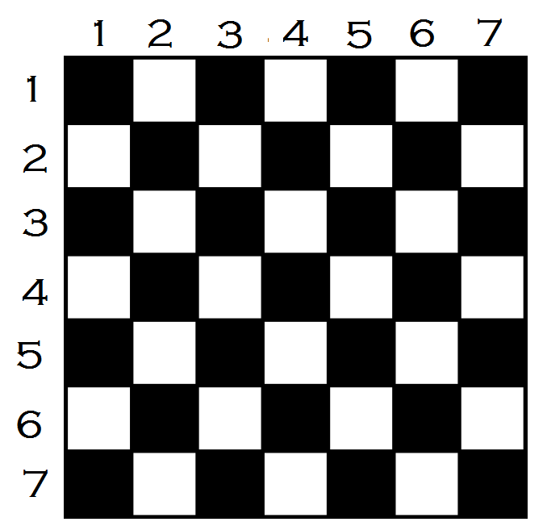
Eg: How many ways are there to select an ordered pair of numbers from 1 to 7 so that the sum is even?

Slide 81
Eg: Suppose that a computer science laboratory has 15 workstations and 10 servers. A cable can be used to directly connect a workstation to a server. For each server, only one direct connection to that server can be active at any time. We want to guarantee that at any time any set of 10 or fewer workstations can simultaneously access different servers via direct connections. Although we could do this by connecting every workstation directly to every server (using 150 connections), what is the minimum number of direct connections needed to achieve this goal?

Slide 82
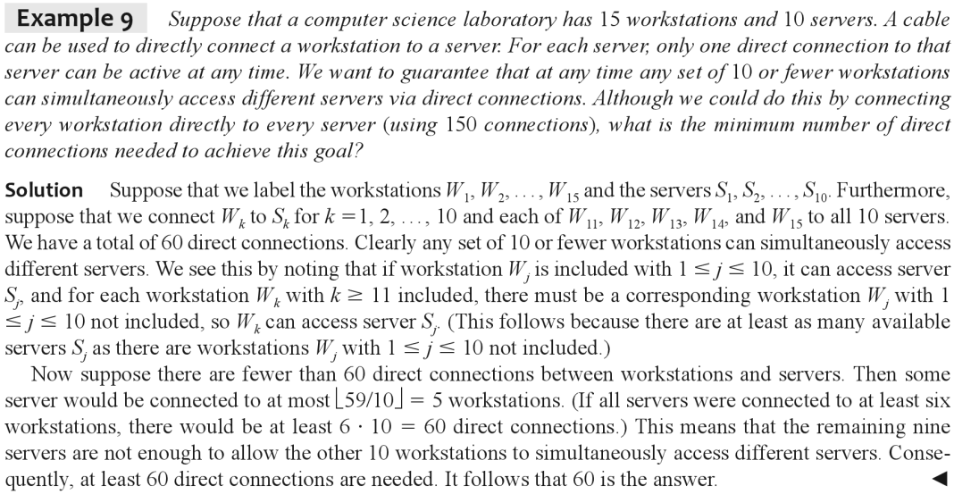

Slide 83
Permutations
A permutation of a set of distinct objects is an ordered arrangement of these objects.
r-permutation of a set of distinct objects is an ordered arrangement of some of the elements (say, r) of the set.
The number of r-permutations of a set with n elements is represented by:
P(n, r)
n^{r}
^{n}P_{r}

Slide 84
Theorem: r-permutations
If n is a positive integer and r is an integer with
0 ≤ r ≤ n, then there are
P(n, r) = n (n - 1) … (n - r + 1)
Proof: We can find the number of r-permutations using the product rule. There are n choices for the first first object. For each of the n choices, there are (n-1) choices for the second object. For each of the n*(n-1) choices, there are (n-2) choices for the third object and so on up to r^{th} object, which has (n-r+1) choices. Therefore, the number of r-permutations of a set of n distinct objects is,
P(n, r) = n * (n-1) * (n-2) * … * (n-r+1).

Slide 85
Corollary: If n and r are integers with 0 ≤ r ≤ n,
then P(n, r) = n! / (n-r)!
P(n, 0) = 1
P(n, r) = n (n - 1) … (n - r + 1)
P(n, r) = {n (n - 1) … (n - r + 1) (n - r)! } / (n - r)!
P(n, r) = n! / (n - r)!

Slide 86
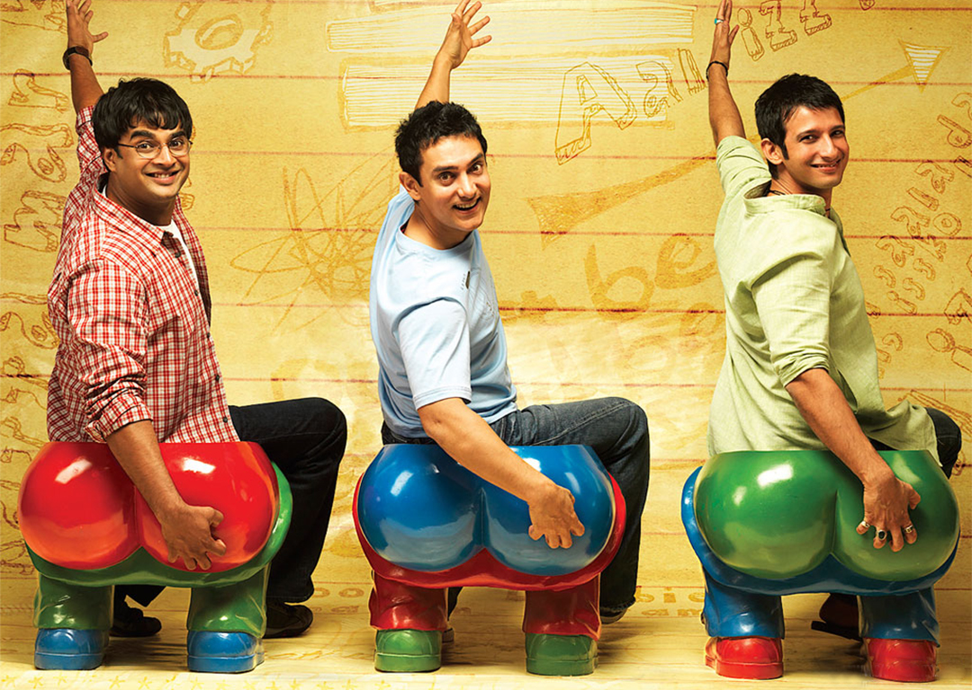
Eg: Suppose a classroom bench can accommodate three students. In how many ways a class of 60 students can sit three at a time on the bench?
Soln: …

Slide 87
Eg: Suppose a classroom bench can accommodate three students. In how many ways a class of 60 students can sit three at a time on the bench?
Soln:
= P(60, 3)
= 60 * 59 * 58
= 60! / 57!
Eg: Suppose that a salesman has to visit 9 different cities starting with his origin city. He must begin his trip from the origin city, but he can visit the other 9 cities in any order he wishes. How many possible orders can the salesman use when visiting these cities?
Soln: …

Slide 88
Eg: Suppose that a salesman has to visit 9 different cities starting with his origin city. He must begin his trip from the origin city, but he can visit the other 9 cities in any order he wishes. How many possible orders can the salesman use when visiting these cities?
Soln:
= P(9, 9)
= 9!
Eg: How many permutations of the string “ABCDEFGHIJ” contain a sub-string “ABC”?
Soln: …

Slide 89
Eg: How many permutations of the letter ABCDEFGHIJ contain the string ABC?
Soln: 8!
Considering ABC as one unit, there are 8 units to permutate.
Imagine listing out all the 10! permutations of the sequence and then searching for the substring “ABC”. The search will have 8! results.

Slide 90
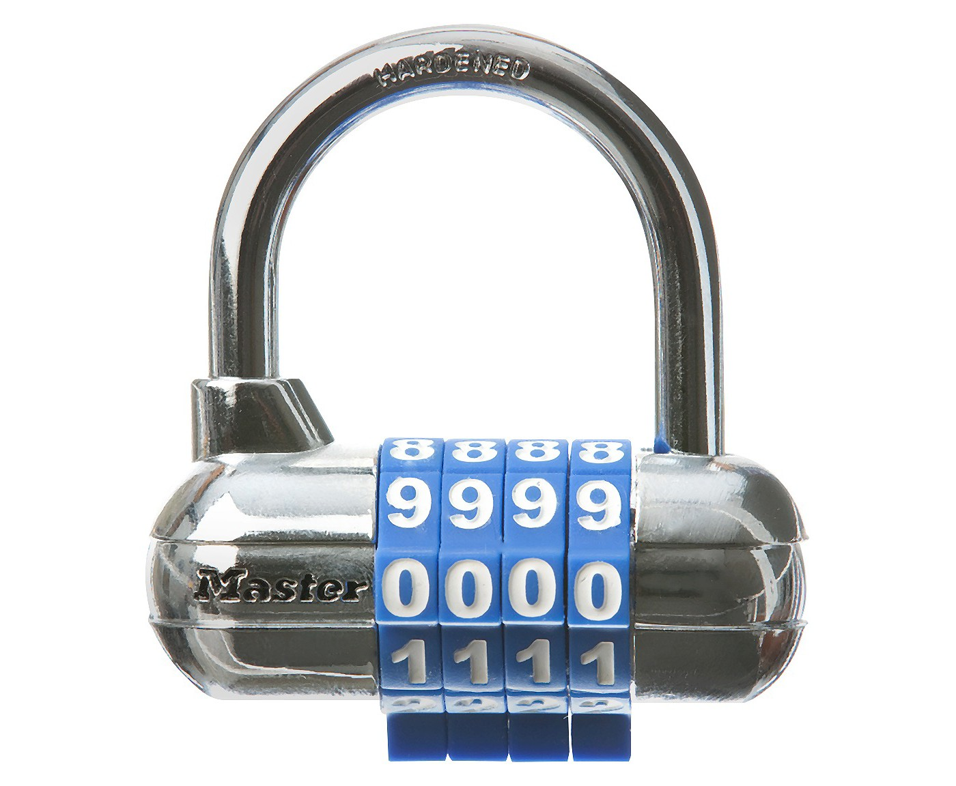
An r-combination of elements of a set is an unordered selection of r elements from the set. Thus, an r-combination is simply a subset of the set with r elements.
Eg: How many 2-combinations of {a, b, c, d} are there?
Soln: {a, b}, {a, c}, {a, d}, {b, c}, {b, d}, {c, d}

Slide 91
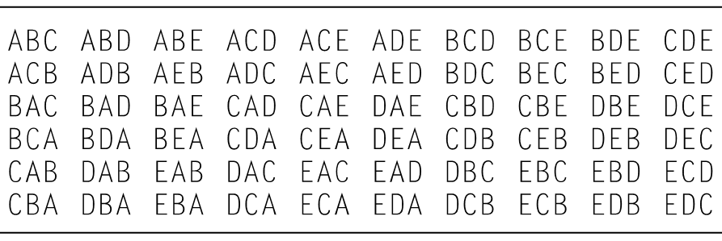
Eg: How many 3-permutations of A, B, C, D, E are there?
Eg: How many 3-combinations of A, B, C, D, E are there?

Slide 92
Theorem: The number of r-combinations of a set with n elements, where n is a nonnegative integer and r is an integer with 0 ≤ r ≤ n, equals
n!
C(n, r) = -----------
(n - r)! r!
Proof:
P(n, r) = C(n, r) * r!
…

Slide 93
Eg: How many 4-combinations of {a, b, c, d, e, f, g, h, i, j} are there?
Soln: P(10, 4) / 4!
= 10! / ((10-4)! * 4!)
= 10! / (6! * 4!)
= 210
Eg: How many 6-combinations of {a, b, c, d, e, f, g, h, i, j} are there?
Soln: P(10, 6) / 6!
= 10! / ((10-6)! * 6!)
= 10! / (4! * 6!)
= 210

Slide 94
Eg: How many poker hands of five cards can be shown from a standard deck of 52 cards?
Soln: …
Eg: From a group of 10 students, in how many ways a committee of 4 students can selected?
Soln: …
Eg: From a group of 10 students, in how many ways a committee of 6 students can selected?
Soln: …

Slide 95
Eg: How many poker hands of five cards can be shown from a standard deck of 52 cards?
Soln: 52! / (5! * 47!)
Eg: From a group of 10 students, in how many ways a committee of 4 students can selected?
Soln: 10! / (6! * 4!)
Eg: From a group of 10 students, in how many ways a committee of 6 students can selected?
Soln: 10! / (4! * 6!)
Corollary: Let n and r be nonnegative integers with r <= n. Then C(n, r) = C(n, n - r)

Slide 96
Eg: How many bit strings of length 8 contain exactly three 1s?
Soln: …
Eg: How many bit strings of length 8 contain exactly five 0s?
Soln: …
Eg: How many bit strings of length n contain exactly r 1s?
Soln: …

Slide 97
Eg: How many bit strings of length 8 contain exactly three 1s?
Soln: 8! / (3! * 5!)
Eg: How many bit strings of length 8 contain exactly five 0s?
Soln: 8! / (5! * 3!)
Eg: How many bit strings of length n contain exactly r 1s?
Soln: n! / ((n-r)! * r!) = C(n, r)

Slide 98
Eg: Suppose that there are 9 faculty members in the mathematics department and 11 in the computer science department. How many ways are there to select a committee to develop a discrete mathematics course at a school if the committee is to consist of three faculty members from the mathematics department and four from the computer science department.
Soln: …

Slide 99
Eg: Suppose that there are 9 faculty members in the mathematics department and 11 in the computer science department. How many ways are there to select a committee to develop a discrete mathematics course at a school if the committee is to consist of three faculty members from the mathematics department and four from the computer science department.
Soln: C(9, 3) * C(11, 4)
= 84 * 330
= (9 * 8 * 7) * (11 * 10 * 9 * 8) / (3 * 2 * 1 * 4 * 3 * 2 * 1)
= (7 * 11 * 10 * 9 * 4)
= 27,720

Slide 100
r-permutation of objects from a set of n objects
Ordered r-selection
n^{r} or ^{n}P_{r}
P(n, r) = n * (n - 1) * … * (n - r + 1) = n! / (n - r)!
P(n, 0) = 1
r-combination of objects from of a set of n obts
Unordered r-selection
^{n}C_{r} or (^{n}_{r})
C(n, r) = P(n, r) / r! = n! / ((n - r)! * r!)
C(n, r) = C(n, n - r)
C(n, 0) = 1

Slide 101
Pascal’s Triangle:
1
1 1
1 2 1
1 3 3 1
1 4 6 4 1
1 5 10 10 5 1
1 6 15 20 15 6 1
…
1
1 1
1 2 1
1 3 3 1
1 4 6 4 1
1 5 10 10 5 1
1 6 15 20 15 6 1
…
[OPTIONAL] Q: Write a computer program to print Pascal’s triangle upto n rows.

Slide 102
Binomial Expansion of (x+y)^{n}:
(x+y)⁰ = 1
(x+y)¹ = x + y
(x+y)² = x² + 2xy + y²
(x+y)³ = x³ + 3x²y + 3x²y + y³
(x+y)⁴ = x⁴ + 4x³y + 6x²y² + 4xy³ + y⁴
1 5 10 10 5 1
1 6 15 20 15 6 1
1 Pascal’s
1 1 Triangle
1 2 1
1 3 3 1
1 4 6 4 1
1 5 10 10 5 1
1 6 15 20 15 6 1
…

Slide 103

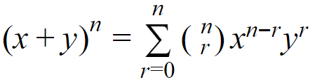
The Binomial Theorem gives the coefficients of the expansion of powers of binomial expressions.
Binomial Theorem: In the expansion of (x+y)^{n} , the coefficient of x^{n-r}y^{r} equals .
Eg: (x+y)³ = (x+y)(x+y)(x+y)
= xxx + xxy + xyx + yxx + xyy + yxy + yyx + yyy
= x³ + 3x²y + 3xy² + y³

Slide 104
Eg: (x+y)⁴ = (x+y)(x+y)(x+y)(x+y)
= C(4,0) xxxx +
C(4,1) xxxy +
C(4,2) xxyy +
C(4,3) xyyy +
C(4,4) yyyy
= x⁴ + 4x³y + 6x²y² + 4xy³ + y⁴

Slide 105


Binomial Theorem: In the expansion of (x+y)^{n} , the coefficient of x^{n-r}y^{r} equals .
Proof: We can prove it by a combinatorial method.
The terms in the product when it is expanded are of the form x^{n-r}y^{r} for r=0,1,2, …, n.
To count the number of terms of the form x^{n-r}y^{r} , note that to obtain such a term it is necessary to choose n-r xs from the n sums and the other r terms in the product are obviously ys.
Therefore, the coefficient of x^{n-r}y^{r} is , which is equal to . Hence the proof.

Slide 106
Eg: What is the expansion of (x+y)⁵?
Soln: x⁵ + 5x⁴y + 10x³y² + 10x²y³ + 5xy⁴ + y⁵
Eg: What is the coefficient of x³y² in the expansion of (x+y)⁵ ?
Soln: C(5,3)

Slide 107
Eg: What is the coefficient of x¹³y¹⁴ in the expansion of (x+y)²⁷ ?
Soln: C(27, 13)
Eg: What is the coefficient of x¹²y¹³ and also x¹³y¹² in the expansion of (2x - 3y)²⁵ ?
Soln:
C(25, 12) * 2¹² * (-3)¹³
C(25, 12) * 2¹³ * (-3)¹²

Slide 108
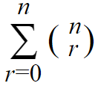
Corollary: Let n be a nonnegative integer. Then
= ?
Hint:
(x+y)³ = (x+y)(x+y)(x+y)
= xxx + xxy + xyx + xyy + yxx + yxy + yyx + yyy
= x³ + 3x²y + 3xy² + y³
(x+y)⁴ = (x+y)(x+y)(x+y)(x+y)
= x⁴ + 4x³y + 6x²y² + 4xy³ + y⁴

Slide 109
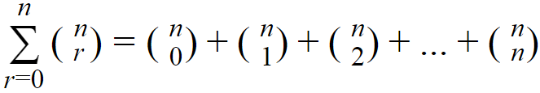
= number of bit strings of length n having 0 1s
+ number of bit strings of length n having 1 1s
+ number of bit strings of length n having 2 1s
…
+ number of bit strings of length n having n 1s
= all possible bit strings of length n counted exactly once
= 2^{n}
We could also explain using subsets of a set adding up to power set.

Slide 110
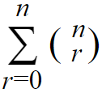
Corollary: Let n be a nonnegative integer. Then
= 2^{n}
Proof: (algebraic)
2^{n} = (1+1)^{n} = 1^{r}1^{n-r} =
The proof using set theory principles is a “combinatorial proof”.

Slide 111
Corollary: For a positive integer n, prove that
(-1)^{r} = 0
Proof: (algebraic)
0 = 0^{n} = ((-1)+1)^{n}
= (-1)^{r}1^{n-r} = (-1)^{r}

Slide 112
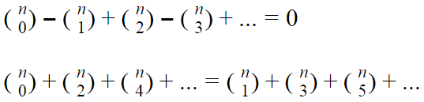
(-1)^{r} = 0
1
1 - 1 = 0
1 - 2 + 1 = 0
1 - 3 + 3 - 1 = 0
1 - 4 + 6 - 4 + 1 = 0
1 - 5 + 10 -10 + 5 - 1 = 0
1 - 6 + 15 - 20 + 15 - 6 + 1 = 0
1 - 7 + 21 - 35 + 35 - 21 + 7 - 1 = 0
1 - 8 + 28 - 56 + 70 - 56 + 28 - 8 + 1 = 0
…

Slide 113
(-1)^{r} = 0
Any combinatorial proof for the corollary?
Eg: How many bit strings of length 10 have even number of 1s in it?
Soln: Same as that the odd number of 1s in it.
= 2^{n} / 2 = 2^{n-1}

Slide 114
Corollary: For a positive integer n, prove that
2^{r} = 3^{n}
Proof: (algebraic)
3^{n} = (1+2)^{n} = …
Any combinatorial proof for the corollary?

Slide 115

Pascal’s Identity:
1
1 1
1 2 1
1 3 3 1
1 4 6 4 1
1 5 10 10 5 1
1 6 15 20 15 6 1
…
1
1 1
1 2 1
1 3 3 1
1 4 6 4 1
1 5 10 10 5 1
1 6 15 20 15 6 1
…
Theorem: Let n and k be positive integers with
n >= k. Then

Slide 116
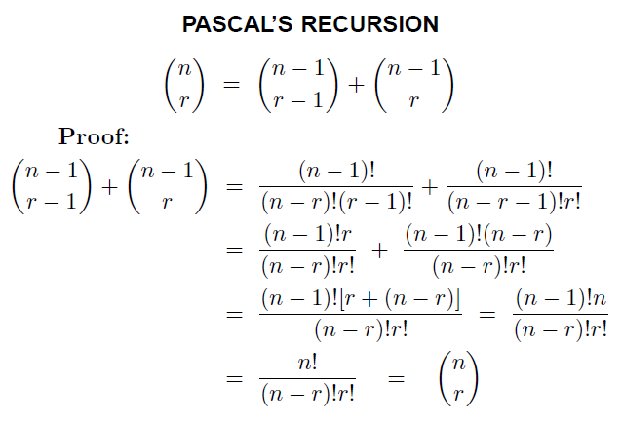
Pascal’s Identity: (Algebraic Proof)

Slide 117

Proof: (Combinatorial method)
Suppose that T is a set containing n+1 elements.
There are subsets of T containing k elements.
Let ‘a’ be an element in T.
A subset of T either contains a along with k-1 elements from T - {a}, or doesn’t contains a and contains k elements from T - {a}. These two sets are disjoint.

Slide 118
subsets of T containing k elements
=
Subsets containing a with k-1 elements from T-{a}
+
Subsets not containing a and containing k elements from T-{a}.
∴

Slide 119
1
1 1
1 2 1
1 3 3 1
1 4 6 4 1
1 5 10 10 5 1
1 6 15 20 15 6 1
…
1
1 1
1 2 1
1 3 3 1
1 4 6 4 1
1 5 10 10 5 1
1 6 15 20 15 6 1
…
Pascal’s Triangle generation:
[Optional] Write a computer program to print Pascal’s triangle upto n rows using Pascal’s identity.
Base cases: (^{n}₀) = (^{n}_{n}) = 1
You won’t need multiplications, only additions are good enough.

Slide 120
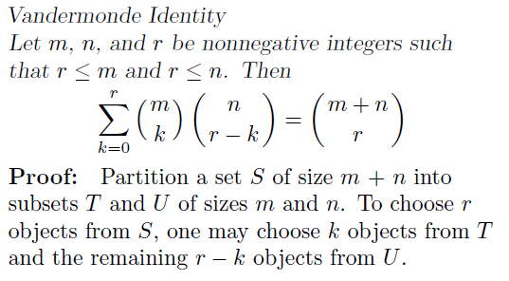

Slide 121
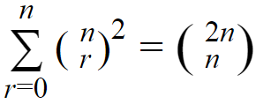
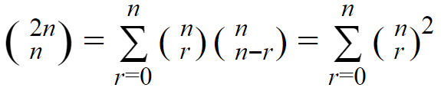
Corollary: For a nonnegative integer n, prove that
Proof: By Vandermonde’s identity

Slide 122
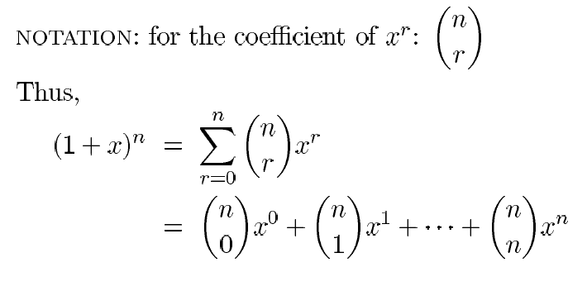
Binomial Coefficients: are the coefficients of the terms x^{r} in the expansion of the binomial (1+x)^{n}

Slide 123
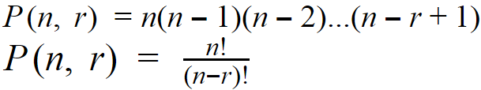

r-permutation of objects from a set of n objects
r-combination of objects from of a set of n obts

Slide 124
Permutations with repetitions: Eg: 26⁴ four-letter strings can be formed from the English alphabet:
AAAA, AAAB, ..., ZZZY, ZZZZ.
Theorem:
The number of r-permutations of a set of n objects with repetition allowed is n^{r}.
Proof: Using the product rule.

Slide 125
Combinations with Repetitions:
Eg: How many ways are there to select 2 coins from a cash box containing 1, 2, 5 and 10 rupees coins?
- Order of selection doesn’t matter
- Coins of a denomination are indistinguishable.
- Practically, there are infinite coins in each box.

Slide 126
Eg: How many ways are there to select 2 coins from a cash box containing 1, 2, 5 and 10 rupees coins?
Soln:
1 1, 1 2, 1 5, 1 10,
2 2, 2 5, 2 10,
5 5, 5 10,
10 10
Eg: How many ways are there to select 6 coins from a cash box containing 1, 2, 5 and 10 rupees coins?
Eg: How many ways are there to distribute 6 chocolates to 4 kids where chocolates are indistinguishable?

Slide 127
Eg: How many ways are there to distribute 6 chocolates to 4 kids where chocolates are indistinguishable?
4 kids each with a partition makes 4-1=3 separators and 6 chocolates to be distributed into the 4 partitions. 3 bars (separators), 6 stars (chocolates) can be mapped to bit strings of length 9 ( = 3+6) having three 1s and six 0s.
C(4 - 1 + 6, 6) = C(9, 6)
= 9*8*7 / (2*3)
= 84 ways

Slide 128
Combinations with Repetitions:
Eg: There are 3 piles of Apples, Blackberries and Android mobile phones. All the phones in a pile are identical. How many ways are there to select 5 of them for your team?
Soln: 3 - 1 bars and 5 stars…
C(3-1+5, 5) = C(7, 5) = 21 ways

Slide 129
Combinations with Repetitions:
Theorem: There are C(n-1+r, r) r-combinations from a set with n elements when repetition of elements is allowed.
Proof: Prove using n-1 bars making space for n kinds of elements and r stars representing the possible positions of r objects.
Also, C(n-1+r, r) = C(n-1+r, n-1)

Slide 130
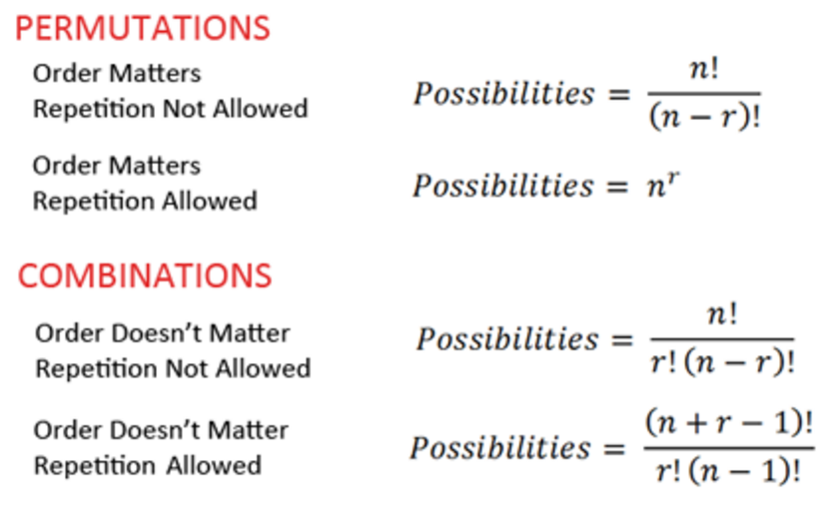

Slide 131
Eg: How many solutions does the equation x₁+x₂+x₃+x₄ = 2 have, where the variables are nonnegative integers?
It’s the number of ways of distributing 2 chocolates to 4 kids.
Using the formula for 2-combinations with repetition allowed from a set of 4 elements,
C(n-1+r, r) = C(4-1+2, 2) = C(5, 2)
= 10 is the number of solutions the equation has.

Slide 132
Eg: How many solutions does the equation x₁+x₂+x₃ = 11 have, where the variables are nonnegative integers?
To find the number of solutions, we can use
r-combinations with repetition allowed from a set with n elements, C(n-1+r, r) where n=3 and r=11.
= C(3-1+11, 11) = C(13,11) = 13*12/2
= 78 is the number of solutions the equation has.

Slide 133
Eg: How many solutions does the equation x₁+x₂+x₃ = 11 have, where the variables are positive integers?
Analogy: 11 chocolates to be distributed to 3 kids with at least one choc to each. Give a choc to each to start with. Now, we are left with distributing 8 chocs for 3 kids. That’s x₁+x₂+x₃ = 8 where the variables are nonnegative integers.
Ans is C(n-1+r, r) where n=3 and r=8.
= C(3-1+8, 8) = C(10, 8) = 10*9/2
= 45 is the number of solutions the equation has.

Slide 134
Eg: How many solutions does the equation x₁+x₂+x₃ = 11 have, where the variables are nonnegative integers and x₁ ≥ 1, x₂ ≥ 2, x₃ ≥ 3 ?
Minimum of 1, 2 and 3, in total 6 allocated to the variables. For the remaining 5, we have a case of 5-combinations from a set of 3 elements when repetition is allowed.
C(n-1+r, r) where n=3 and r=5.
= C(3-1+5, 5) = C(7, 5) = 7*6/2
= 21 is the number of solutions the equation has.

Slide 135
Permutations with Indistinguishable Objects:
Eg: How many different strings can be made by reordering the letters of the word PESU?
= 4!
Eg: How many different strings can be made by reordering the letters of the word LOL?

Slide 136
Permutations with Indistinguishable Objects:
Eg: How many different strings can be made by reordering the letters of the word LOL?
< 3! (LLO, LLO, LOL, LOL, OLL, OLL)
= 3 (LLO, LOL, OLL)
Eg: How many different strings can be made by reordering the letters of the word LOLL?

Slide 137
Permutations with Indistinguishable Objects:
Eg: How many different strings can be made by reordering the letters of the word LOLL?
< 4! (LLLO, LLLO, , LLLO, LLLO, LLLO, , LLLO)
= 4!/3! = 4 (LLLO, LOLL, LLOL, LLOL)
Eg: How many different strings can be made by reordering the letters of the word LOLOL?
= 5!/(3!*2!) = 10

Slide 138
Permutations with Indistinguishable Objects:
Eg: How many bit strings of length 8 has exactly three 1s?
C(8, 3) = 8! / (5! * 3!) = 56
It’s also number of permutations of 8 objects in which 5 are of Type 1 and 3 are of type 2.
Eg: How many numbers of length 10 in base-3 has exactly two 0s, three 1s and remaining five 2s?

Slide 139
Permutations with Indistinguishable Objects:
Eg: How many numbers of length 10 in base-3 has exactly two 0s, three 1s and remaining five 2s?
C(10, 2) * C(8, 3) * C(5, 5)
= 10! / (8! 2!) * 8! / (5! 3!) * 5! / (5! * 0!)
= 10! / (2! 3! 5!)

Slide 140
Eg: How many different strings can be made by reordering the letters of the word SUCCESS?
Less than 7!
3 Ss placed among 7 positions: C(7,3)
2 Cs placed among 4 positions: C(4,2)
1 U placed among 2 positions: C(2,1)
1 E placed among 1 position: C(1,1)
= C(7,3) * C(4,2) * C(2,1) * C(1,1)
= 7! / (3!*4!) * 4!/ (2!*2!) *2!/(1!*1!) *1!/(1!*0!)
= 7! / (3!*2!*1!*1!)

Slide 141
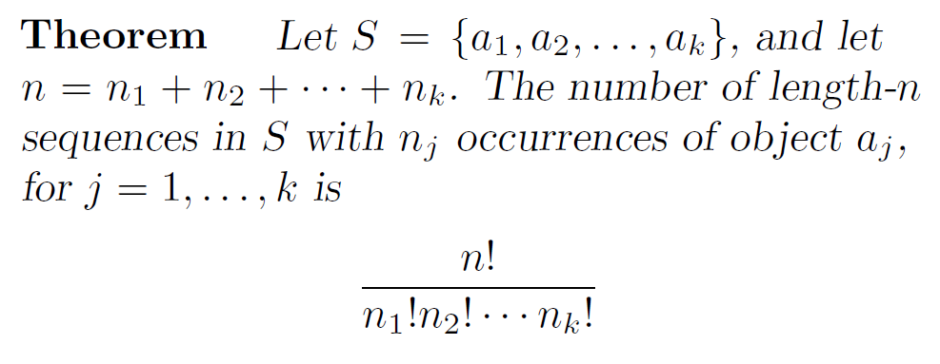
Permutations with Indistinguishable Objects:
Proof: Use the explanation of the example.
n₁ a₁s can be placed among n positions in C(n,n₁) ways
n₂ a₂s can be placed among (n-n₁) positions in C(n-n₁,n₂) ways

Slide 142
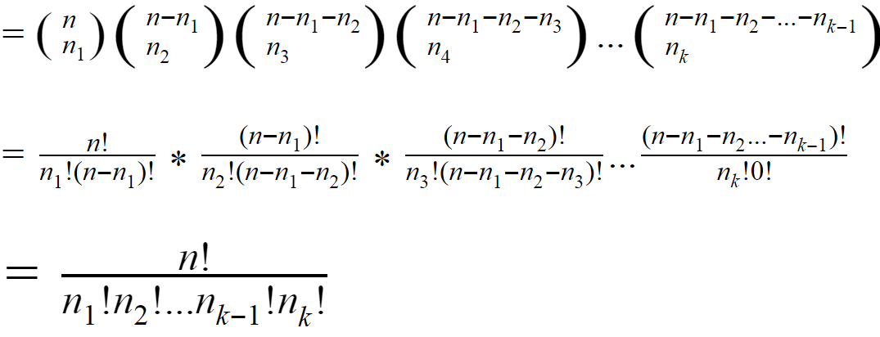
By the product rule, the total number of different permutations is
C(n,n₁)C(n-n₁,n₂)C(n-n₁-n₂,n₃) … C(n-n₁-n₂- … -n_{k-1}, n_{k})

Slide 143
Distributing Objects into Boxes:
Objects can be distinguishable / indistinguishable
(aka labeled / unlabeled)
Boxes can be distinguishable / indistinguishable
(aka labeled / unlabeled)
Distributing r distinguishable / indistinguishable objects into n distinguishable / indistinguishable boxes.

Slide 144
Distinguishable Objects and Distinguishable Boxes:
Eg: For 4 mentors, how many ways are there to make teams of 5 students each from a class of 52 students?
Students are the Objects.
Mentors are the Boxes.
= C(52,5) * C(47,5) * C(42,5) * C(37,5)
= (52!/(47!*5!)) * (47!/(42!*5!)) * (42!/(37!*5!)) * (37!/(32!*5!))
= 52! / (5! * 5! * 5! * 5! * 32!)

Slide 145
Distinguishable Objects and Distinguishable Boxes:
Eg: How many ways are there to distribute hands of 5 cards to each of the 4 players from the standard deck of 52 cards?
Cards are the Objects.
Players are the Boxes.
= C(52,5) * C(47,5) * C(42,5) * C(37,5)
= (52!/(47!*5!)) * (47!/(42!*5!)) * (42!/(37!*5!)) * (37!/(32!*5!))
= 52! / (5! * 5! * 5! * 5! * 32!)

Slide 146
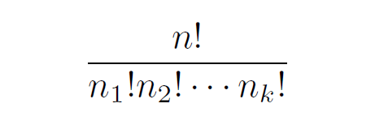
Distinguishable Objects & Distinguishable Boxes:
Number of ways to distribute n distinguishable objects into k distinguishable boxes so that n_{i} objects are placed into box i, i = 1,2, …,k, equals

Slide 147
Indistinguishable Objects & Distinguishable Boxes:
Eg: How many ways are there to place 10 indistinguishable balls into eight distinguishable bins?
This is same as distributing 10 chocolates to 8 kids.
It’s 10-combinations with repetition allowed from a set of 8 elements.
= C(8-1+10, 10)

Slide 148
Indistinguishable Objects & Distinguishable Boxes:
There are C(n-1+r, r) ways to place r indistinguishable objects into n distinguishable boxes.

Slide 149
Eg: How many ways are there to distribute 6 chocolates to 4 kids? (Note that chocolates are indistinguishable and kids are distinguishable)
Eg: How many ways are there to distribute 6 distinguishable toys to 4 kids? (Note that toys are distinguishable here and kids are also distinguishable as usual)

Slide 150
Eg: How many ways are there to distribute 6 chocolates to 4 kids? (Note that chocolates are indistinguishable and kids are distinguishable)
= C(4-1+6, 6) = C(9, 6) = 9! / (3! * 6!) = 84
Eg: How many ways are there to distribute 6 distinguishable toys to 4 kids? (Note that toys are distinguishable here and kids are also distinguishable as usual)
= 4⁶ because each toy has a choice of 4 kids to go to!
Incorrect answers: 9!/3!, C(9,6)*6!, P(6,4)

Slide 151
Distinguishable Objects & Indistinguishable Boxes:
Eg: How many ways are there to distribute 80 different students into 25 indistinguishable team?
Eg: How many ways are there to assign 4 students into 3 indistinguishable team (not more than 3 teams)?
4 students in 1 team: {{A,B,C,D}}
in 2 teams: {{A,B,C},{D}}, {{A,B,D},{C}},
{{A,C,D},{B}}, {{B,C,D},{A}},
{{A,B},{C,D}}, {{A,C},{B,D}}, {{A,D},{B,C}}
in 3 teams: {{A,B},{C},{D}}, {{A,C},{B},{D}},
{{A,D},{B},{C}}, {{B,C},{A},{D}},
{{B,D},{A},{C}}, {{C,D},{A},{B}}
Possibilities = 1+7+6 = 14 ways

Slide 152
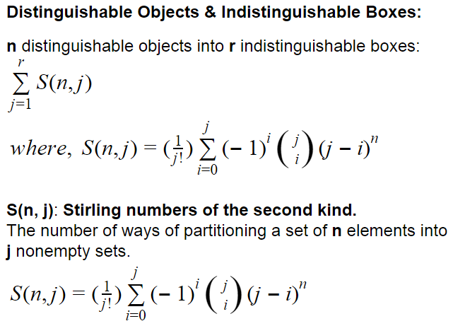

Slide 153
Indistinguishable Objects &
Indistinguishable Boxes:
Eg: How many ways are there to pack 6 copies of the same book into 4 identical bundles (not more than 4 bundles)?
6
5,1
4,2
4,1,1
3,3
3,2,1
3,1,1,1
2,2,2
2,2,1,1
= 9 ways

Slide 154
n Indistinguishable Objects &
r Indistinguishable Boxes:
n as the sum of at most r positive integers in non-decreasing order.
a₁+a₂+ … +a_{j} = n
0 < a₁ ≤ a₂ ≤ … ≤ a_{j}, and j ≤ r
a₁,a₂, … , a_{j} is a partition of n into j positive ints.
There are P_{r}(n) ways to distribute n indistinguishable objects into r indistinguishable boxes. No simple closed formula exists for this number.

Slide 155
Eg: In a batch of 12 students, three of them will be awarded “A” grade, four of them “B” grade and the rest “C” grade. In how many ways the grades can be awarded for the 12 students? [2015 April]
Eg: How many positive integers below ten thousand are there in which the sum of the digits adds up to 12? [2015 April]

Slide 156
Eg: In a batch of 12 students, three of them will be awarded “A” grade, four of them “B” grade and the rest “C” grade. In how many ways the grades can be awarded for the 12 students? [2015 April]
Solution 1: It’s a case of labelled objects into labelled boxes.
12! / (3! * 4! * 5!)
= 27720 ways
Solution 2: Permutation with some indistinguishable objects
C(12, 3) * C(9, 4) * C(5, 5)
= 220 * 126 * 1
= 27720 ways

Slide 157
Eg: How many positive integers below ten thousand are there in which the sum of the digits adds up to 12? [2015 April]
Solution: 4 digit numbers.
x₁ + x₂ + x₃ + x₄ = 12, where x_{i} ≤ 9 for i = 1, 2, 3, 4.
C(4 – 1 + 12, 12) = C(15, 12) solutions without the condition of x_{i} ≤ 9.
Negate the cases where an x_{i} ≥ 10.
x₁ + x₂ + x₃ + x₄ = 2 because only one digit can be ≥ 10.
Answer = C(15, 12) – 4* C(5, 2)
= 455 – 4 * 10 = 415

Slide 158
Eg: Suppose an username to sign up for an account has to be 8, 9 or 10 characters long. Characters are to be case-insensitive alphanumeric and the first character cannot be a digit. Also, the usernames cannot be palindromes. How many usernames the system supports? (Palindrome: reads the same backwards as forwards) [2014 April]
Eg: A group contains n married couples (a husband and his wife makes a couple); n men and n women. How many ways are there to arrange:
(i) these people in a row?
(ii) these people in a row if the men and women alternate?
(iii) these people in a row if couples are next to each other? [2014 April]

Slide 159
Eg: Suppose an username to sign up for an account has to be 8, 9 or 10 characters long. Characters are to be case-insensitive alphanumeric and the first character cannot be a digit. Also, the usernames cannot be palindromes. How many usernames the system supports? (Palindrome: reads the same backwards as forwards) [2014 April]
Soln:
Number of palindromes = (26*36³) + (26*36⁴) + (26*36⁴)
Required answer would be:
(26*36⁷)-(26*36³) + (26*36⁸)-(26*36⁴) + (26*36⁹)-(26*36⁴)

Slide 160
Eg: A group contains n married couples (a husband and his wife make a couple); n men and n women. How many ways are there to arrange:
(i) these people in a row?
(ii) these people in a row if the men and women alternate?
(iii) these people in a row if couples are next to each other? [2014 April]
Soln:
(i) (2n)!
(ii) 2(n!)²
(iii) n! * 2^{n}

Slide 161
Eg: There are 4 piles one of each of Orange, Mosambi, Mango and Bananas. All the fruits in a pile are identical. How many ways are there to select 5 of them?
Eg: How many ways are there to distribute 80 different students into not more than 12 indistinguishable team?
Eg: In how many different ways can 5 elements be selected in order from a set with 4 elements when repetition is allowed?

Slide 162
Eg: There are 4 piles one of each of Orange, Mosambi, Mango and Bananas. All the fruits in a pile are identical. How many ways are there to select 5 of them?
Soln: C(4-1+5, 5) = C(8, 5) = 56

Slide 163

Eg: How many ways are there to distribute 80 different students into not more than 12 indistinguishable team?
Soln:

Slide 164
Eg: Eg: In how many different ways can 5 elements be selected in order from a set with 4 elements when repetition is allowed?
Soln: 4⁵

Slide 165
Eg: Every day Pappu randomly chooses a sandwich for lunch from three choices of sandwiches. How many different ways are there for Pappu to choose sandwiches for the 5 working days of a week if the order in which the sandwiches are chosen matters?
Eg: Every day Pappu randomly chooses a sandwich for lunch from three choices of sandwiches. How many different ways are there for Pappu to choose sandwiches for the 5 working days of a week if the order in which the sandwiches are chosen does not matters?

Slide 166
Eg: Every day Pappu randomly chooses a sandwich for lunch from three choices of sandwiches. How many different ways are there for Pappu to choose sandwiches for the 5 working days of a week if the order in which the sandwiches are chosen matters?
Soln: 3⁵

Slide 167
Eg: Every day Pappu randomly chooses a sandwich for lunch from three choices of sandwiches. How many different ways are there for Pappu to choose sandwiches for the 5 working days of a week if the order in which the sandwiches are chosen does not matters?
Soln: C(3-1+5, 5) = C(7, 5) = 21

Slide 168
Eg: How many ways are there to assign 3 distinct jobs to 5 employees if each employee can be given at most one job?
Eg: How many ways are there to assign 3 distinct jobs to 5 employees if each employee can be given more than one job?

Slide 169
Eg: How many ways are there to assign 3 distinct jobs to 5 employees if each employee can be given at most one job?
Soln: P(5, 3) = 60
Eg: How many ways are there to assign 3 distinct jobs to 5 employees if each employee can be given more than one job?
Soln: 5³
Why not 3⁵?

Slide 170
Eg: How many different combinations of 1, 2, 5 and 10 rupee coins can a piggy bank contain if it has 10 coins in it?
Eg: A mobile store has 3000 identical Android phones. How many ways are there to store these phones in their 3 unlabelled storerooms?

Slide 171
Eg: How many different combinations of 1, 2, 5 and 10 rupee coins can a piggy bank contain if it has 10 coins in it?
Soln: It’s 10-combinations from a set of 4 elements with repetition allowed.
C(4-1+10, 10)
= C(13, 10)
= 13*12*11/3!
= 286

Slide 172
Eg: A mobile store has 3000 identical Android phones. How many ways are there to store these phones in their 3 unlabelled storerooms?
Soln: 3000 unlabelled objects to be placed into 3 unlabelled boxes.
P_{r}(n) = P₃₀₀₀(3) is the number of ways of distributing 3000 unlabelled objects into 3 unlabelled boxes.

Slide 173
Eg: How many solutions are there to the equation
x₁ + x₂ + x₃ + x₄ + x₅ = 21
(x_{i} are nonnegative ints) with the following conditions.
no conditions
x₁ ≥ 1
x_{i} ≥ 2 for i = 1, 2, 3, 4, 5
0 ≤ x₁ ≤ 10
2 ≤ x₁ < 5
x₁ ≤ 3, x₂ ≤ 4
0 ≤ x₁ ≤ 3, 1 ≤ x₂ < 4, x₃ ≥ 15

Slide 174
x₁ + x₂ + x₃ + x₄ + x₅ = 21
no conditions
C(5-1+21, 21) = C(25, 21) = 12650
x₁ ≥ 1
x₁ + x₂ + x₃ + x₄ + x₅ = 20
C(5-1+20, 20) = C(24, 20) = 10626
x_{i} ≥ 2 for i = 1, 2, 3, 4, 5
x₁ + x₂ + x₃ + x₄ + x₅ = 11
C(5-1+11, 11) = C(15, 11) = 1365
0 ≤ x₁ ≤ 10
12650 - (when x₁≥11) = 12650 - C(14,10) = 11649
2 ≤ x₁ < 5
...

Slide 175
x₁ + x₂ + x₃ + x₄ + x₅ = 21
2 ≤ x₁ < 5
x₁ + x₂ + x₃ + x₄ + x₅ = 21-2, and x₁ < 3
C(23,19) - (when x₁≥3) = C(23,19) - C(20,16)
0 ≤ x₁ ≤ 3, 0 ≤ x₂ ≤ 4
C(25,21) - (when x₁ ≥ 4 or x₂ ≥ 5)
= C(25,21) - ((x₁ ≥ 4) + (x₂ ≥ 5) - (x₁ ≥ 4 and x₂ ≥ 5))
= C(25,21) - C(21,17) - C(20,16) + C(16,12)
0 ≤ x₁ ≤ 3, 1 ≤ x₂ < 4, x₃ ≥ 15
x₁ + x₂ + x₃ + x₄ + x₅ = 5 with x₁ ≤ 3 and x₂ < 3
= C(9,5) - ((x₁ ≥ 4) + (x₂ ≥ 3) - ((x₁ ≥ 4) and (x₂ ≥ 3)))
= C(9,5) - C(5,1) - C(6,2) + 0
= 126 - 5 - 15 = 106

Slide 176
Eg: Given infinite number of red and blue balls, how many ways are there to arrange n balls such that no two red balls are adjacent?
Number of red balls can only from 0 to ⌈n/2⌉. Number of arrangements based on number of red balls:
0: 1
1: n
2: three bars and n-3 stars = C(n, 3)
Two red can’t be next to each other and hence consider one of the blue in between the red balls as a “bar” along with the two blue balls.

Slide 177
0: 1
1: n
2: three bars and n-3 stars = C(n, 3)
3: five bars and n-5 stars = C(n, 2*3-1)
4: 4+3 bars and n-7 stars = C(n, 2*4-1)
5: 5+4 bars and n-9 stars = C(n, 2*5-1)
6: 2*6-1 bars and n-(2*6-1) stars = C(n, 2*6-1)
i ≤ ⌈n/2⌉: 2*i-1 bars and n-(2*i-1) stars = C(n, 2*i-1)
_{⌈n/2⌉}
Soln: 𝚺 C(n, 2 * i - 1 )
^{i=0}

Slide 178
Eg: How many ways are there to distribute 5 balls into 3 boxes if each box must have at least 1 ball in it if
both the balls and boxes are labeled?
the boxes are labeled, but balls are not?
the balls are labeled, but boxes are not?
both the balls and boxes are unlabeled?
Eg: How many ways are there to distribute 5 balls into 7 boxes if each box must have at most 1 ball in it if
both the balls and boxes are labeled?
the boxes are labeled, but balls are not?
the balls are labeled, but boxes are not?
both the balls and boxes are unlabeled?

Slide 179
Eg: How many ways can n books be placed on k distinguishable shelves
(i) if the books are indistinguishable copies of the same title?
(ii) if no two books are the same?
(iii) if no two books are the same, and the positions of the books on the shelves matter?

Slide 180
Eg: How many ways can n books be placed on k distinguishable shelves
(i) if the books are indistinguishable copies of the same title?
= C(k-1+n, n)
(ii) if no two books are the same?
= k^{n}
(iii) if no two books are the same, and the positions of the books on the shelves matter?
= (k-1+n)! / (k-1)!

Slide 181
Eg: Suppose that a basketball league has 32 teams, split into 2 conferences of 16 teams each. Each conference is split into 3 divisions. Suppose that the North Central Division (NCD) has 5 teams. Each of the teams in NCD plays 4 games against each of the other teams in this division, 3 games against each of the 11 remaining teams in its conference, and 2 games against each of the 16 teams in the other conference. In how many different orders can the games of one of the teams in the NCD be scheduled?
Soln: A team in NCD plays
4 games with each of 4 teams a1, .. a4.
3 games with each of 11 teams b1, .. b11.
2 games with each of 16 teams c1, .. c16.
Total games = 4*4 + 3*11 + 2*16 = 81 games.
The solution can be visualized as the number of arrangements of 81-character long string in which a1 appears 4 times, a2 appears 4 times, etc. It’s a problem of permutation with some indistinguishable objects. The answer would be: 81! / ( (4!)⁴(3!)¹¹(2!)¹⁶ )

Slide 182
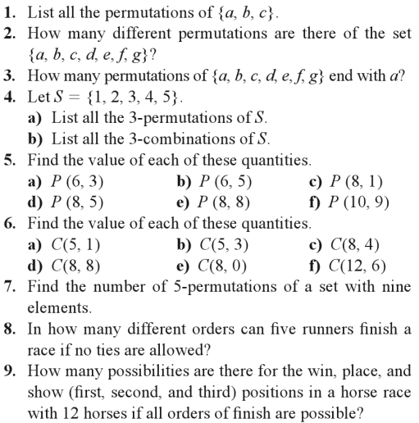

Slide 183
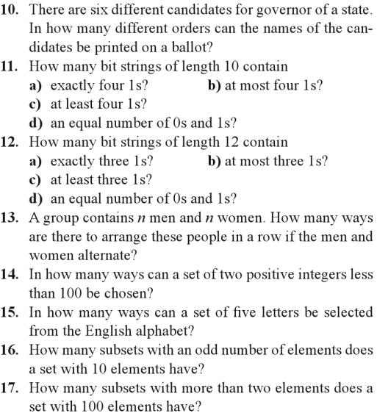

Slide 184
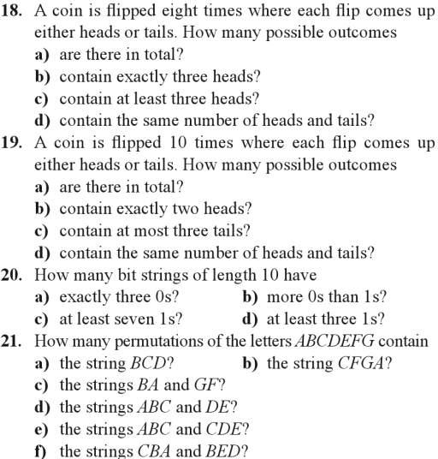

Slide 185
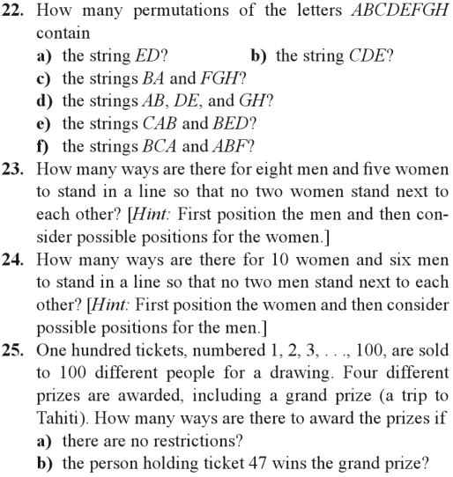

Slide 186
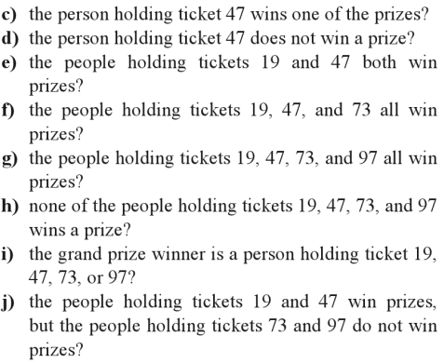

Slide 187
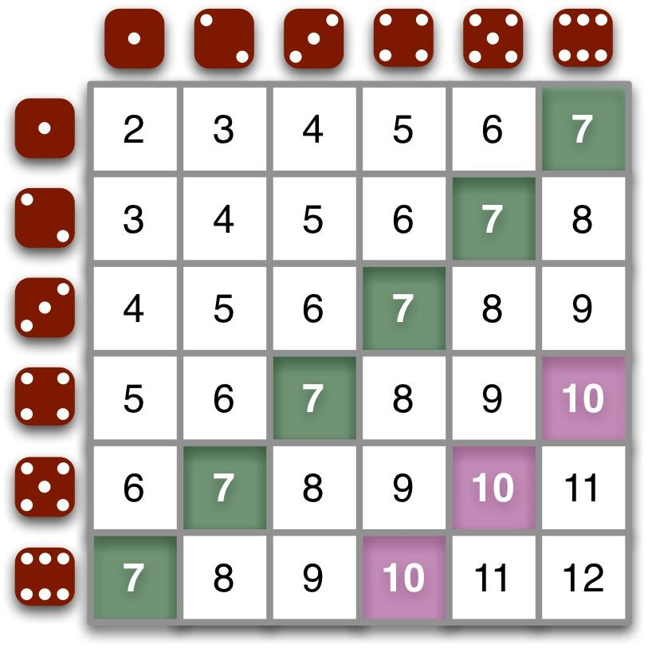
Make the days count instead of counting the days!
< End of Counting />

